Slide 1
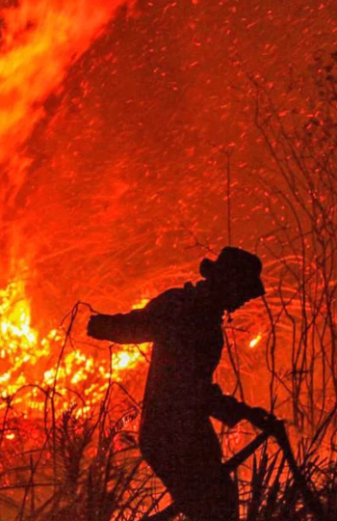
PREDICTING HOTSPOT INTENSITIES
Group ID: 3
Say Yueyang, Symus | He Zeqing | Kwek Yan Qing

Slide 2
TABLE OF CONTENTS
1
INTRODUCTION
2
MOTIVATION
3
PROPOSED SOLUTION
4
ANALYSIS
5
CONCLUSION

Slide 3
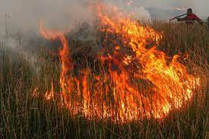
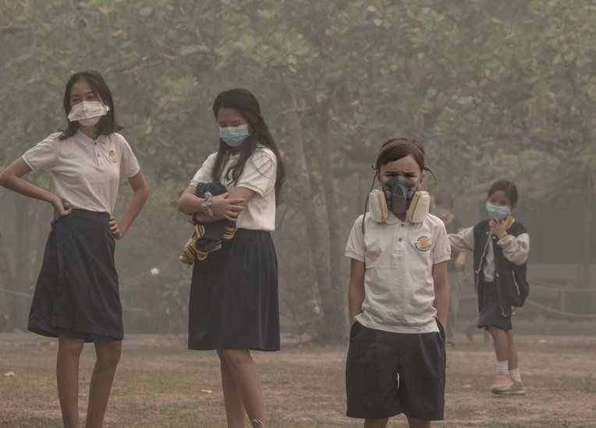
INTRODUCTION
Indonesia’s Forest Fires
Haze Problem
Notes:
Haze is one major form of air pollution that Singaporeans face annually. The presence of haze is attributed to the forest fires in Sumatra, Indonesia. Due to the increase in demand of commercial crops, Indonesian farmers have resorted to shifting agriculture, which includes the large-scale slash-and-burn of forest land to produce fertile planting grounds. The resulting air pollution is then spread across the region by the climatic phenomenon El Nino, enveloping Singapore in a blanket of haze and affecting the overall health of Singaporeans. In 2020, Indonesia fires torched approximately 207,000 hectares of forests from January to September. While the area is smaller compared to previous years, the burning resulted in a US$5.2 billion cost towards the Indonesian economy, and the occurrence of toxic smog over the city.

Slide 4
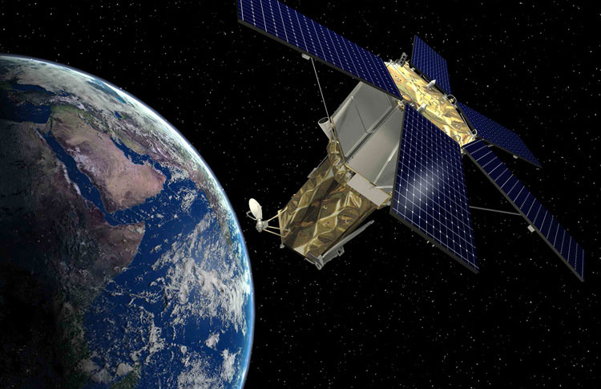
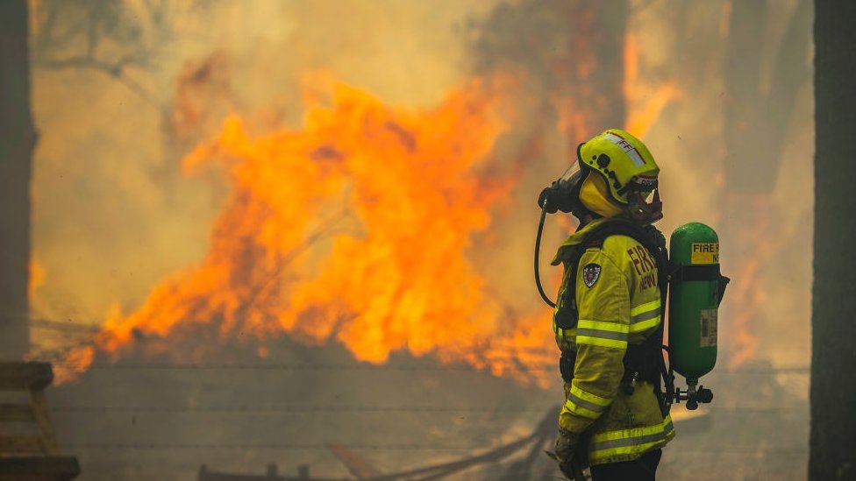
MOTIVATION
Brightness
data
Fight Fires
Prevent slash and Burn
Locate Fire response teams
Can we predict how intense a fire will be based on where it starts and how bright the fire burns?
Notes:
We want to see are able to predict how intense a fire will be based on location and brightness data captured by the satellite imaging. If there is a relation, we can utilize more satellites to detect fires and locate firefighters and agencies against slash and burn near places which tends to produce the worst fires.

Slide 5
PROPOSED SOLUTION
Data Acquisition and Visualization
Pre-processing
Generate Predictive Models
Compare Accuracy of Forecast
To predict Fire Radiative Power (FRP) from location and brightness data.

Slide 6
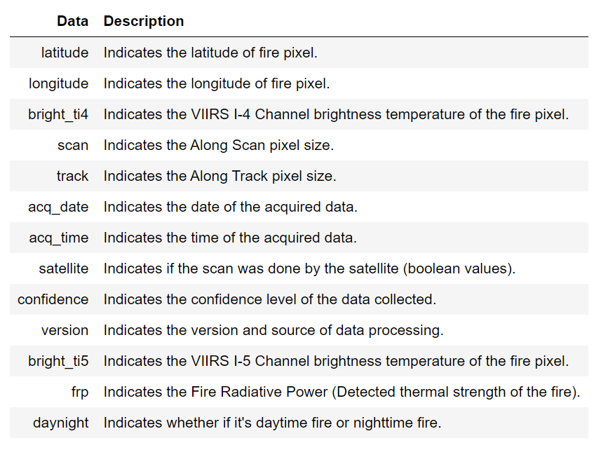
Data Acquisition
Data from NASA’s Fire Information for Resource Management System (FIRMS).
Visible Infrared Imaging Radiometer Suite (VIIRS) sensor aboard their NOAA-20 weather satellite.
Notes:
Project description
Motivation
Proposed solution
Analysis
Conclusion/future work

Slide 7
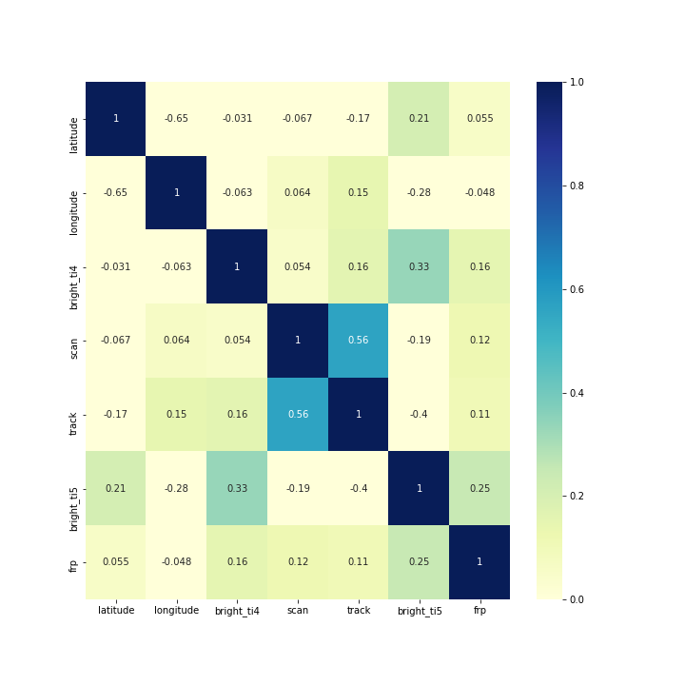
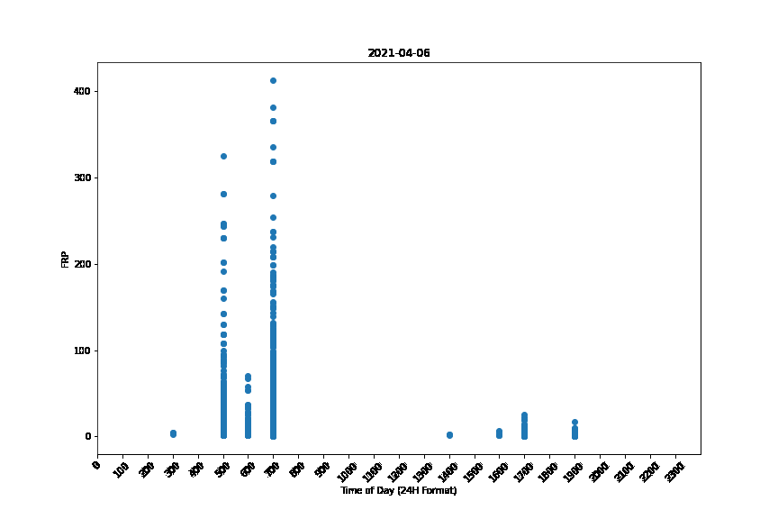
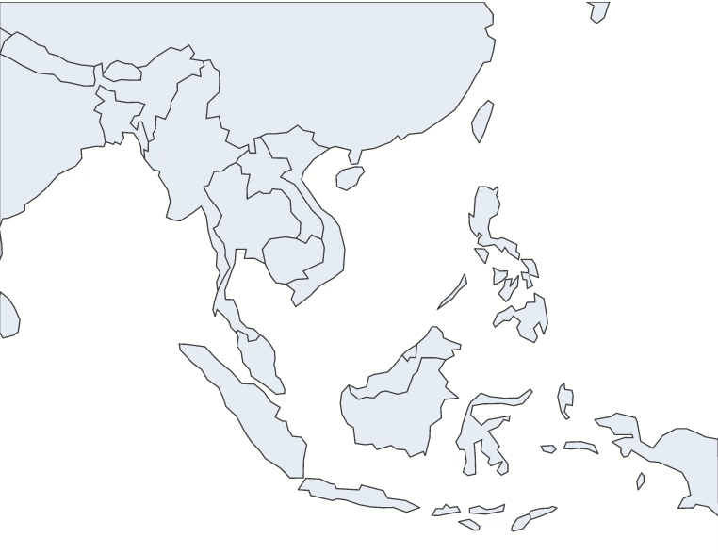
Data Visualization
FRP-Time Relation
Covariance Heatmap
Geographical
Map

Slide 8
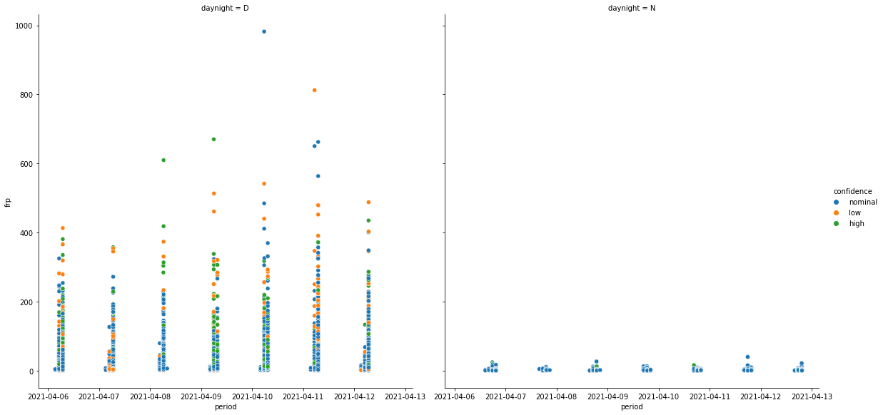
Data Visualization

Slide 9
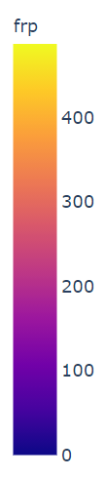
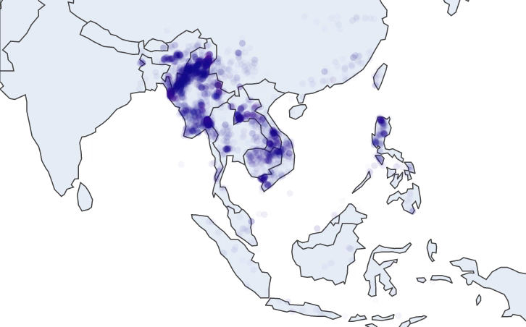
Data Visualization
- Fire Data within the same region is concentrated to a certain location
- Patterns in when the fires are detected within the same 7 day period.

Slide 10
Data Visualization – Correlation Heatmap
Trends Observed:
Correlation between Brightness & Fire Radiative Power
Correlation between Scan and Track (Related to Satellite Movement)

